Slide 1

Myanimelist Topic Sentiment Analysis
Presentation by: Xinyu Huang, Kelvin Nguyen, Wendy Wang

Slide 2

Research Question:
Originally, the plan was to find a way to filter out fake reviews.
Flaws: 1. Web scraping is not allowed for myanimelist website
2. There is no way of determining a fake review without labels
Research Question:
Are we able to find similar topics in each review that could tell us the pros and cons of certain shows based off sentiment of topic modeling?
TLDR:
If Show1 had many reviews about how good the animation was -> in the topic modeling, the topics will be ‘good animation’, if Show2 had bad story telling, topic will be ‘bad story’, from this, we can derive sentiment off topics of reviews. ‘Bad story’ topic -> Lower Vader Compound score because it is more negative than positive
Algorithms and Tools used:
VADER sentiment
LDA Topic Modeling

Slide 3

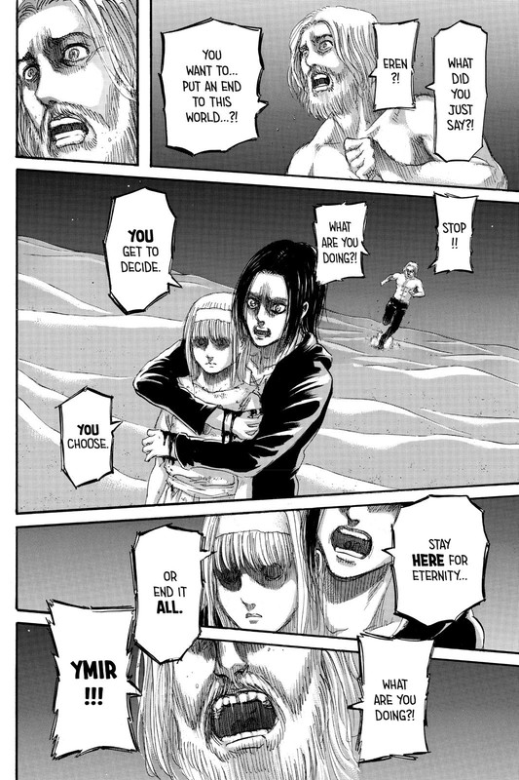
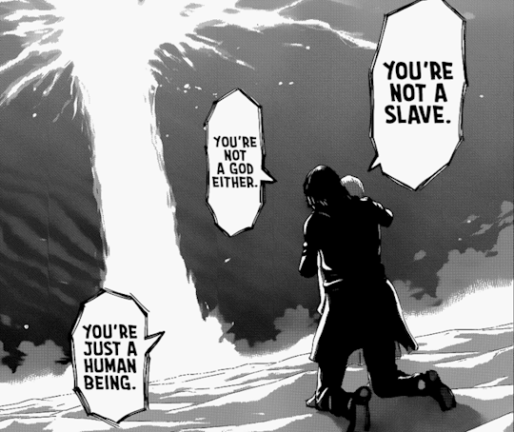
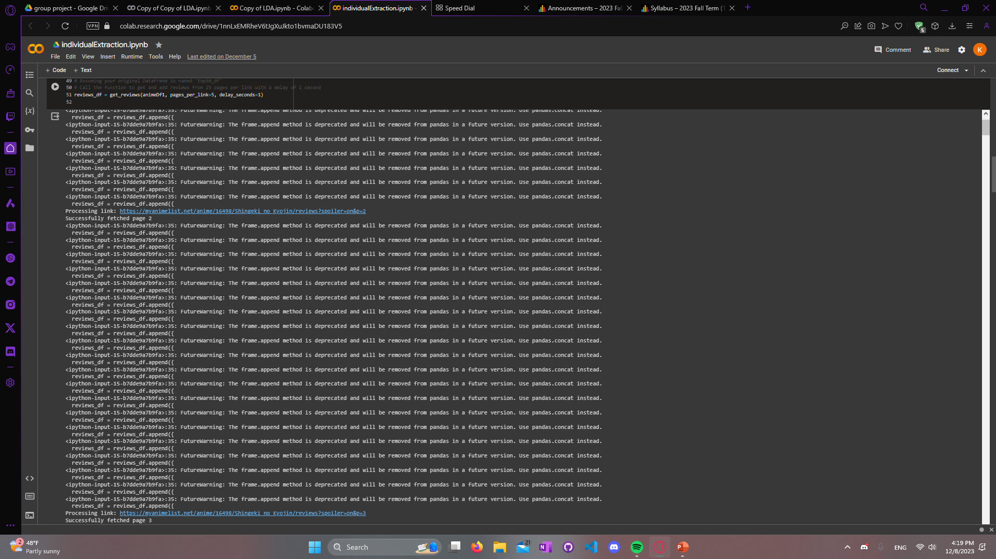
Step 1: Web Scraping 100 reviews for Top 50 animes = 5000 reviews = IP BANNED

Slide 4
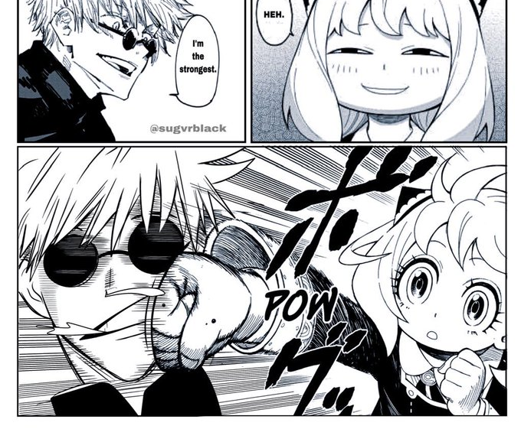
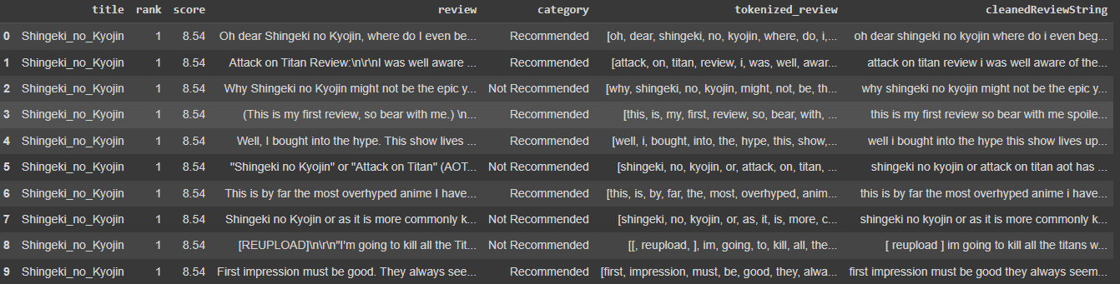

Step 2: Preprocessing For Vader Sentiment
Removing stop words that are commonly used
Breaking up a sentence into a list of words using word tokenization
Remove special characters and convert everything to lowercase

Slide 5

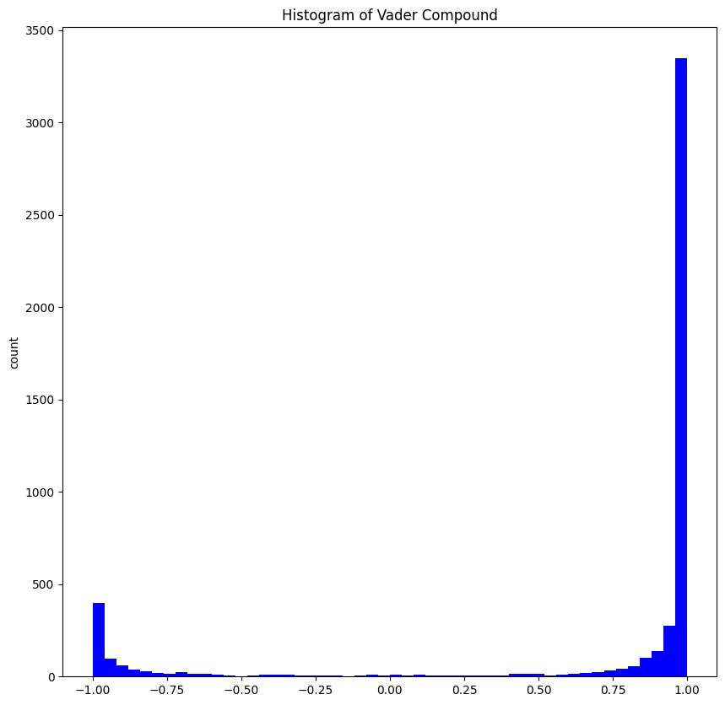
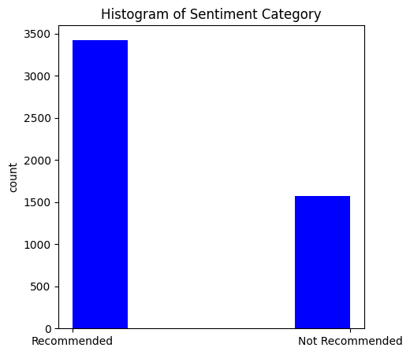
Our data contain 5000 reviews
With pre-labels of Recommended
& Not Recommended
Step 3: Vader Sentiment Analysis
Extracting components from vader scores
Calculating the average vader compound score for each show
Vader Compound measures sentiment of a text.
Ex: "happy" has a high valence score
"sad” has a low valence score
*Sometimes the context can affect a words valence score too
Vader sentiment based on review
Pre-labeled data from website

Slide 6

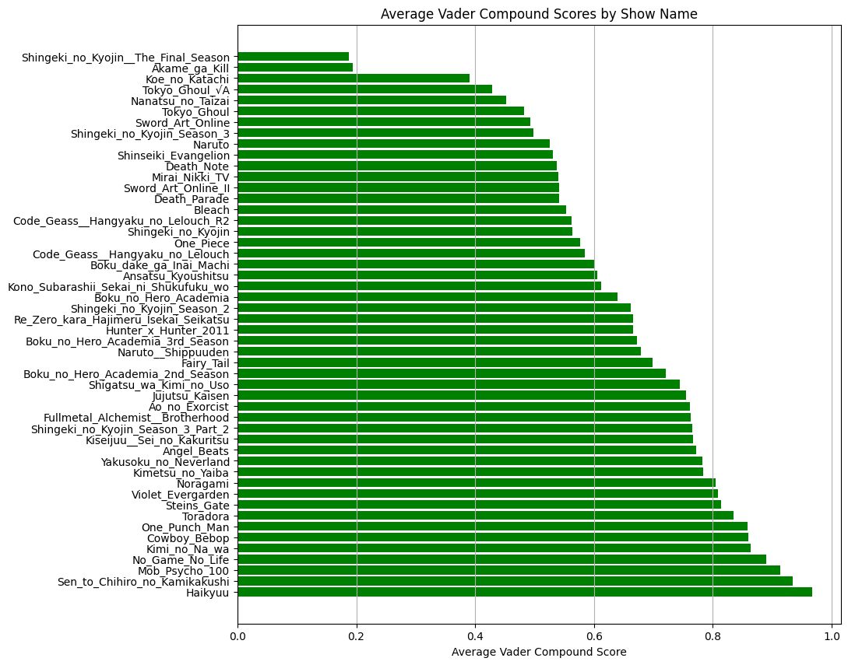
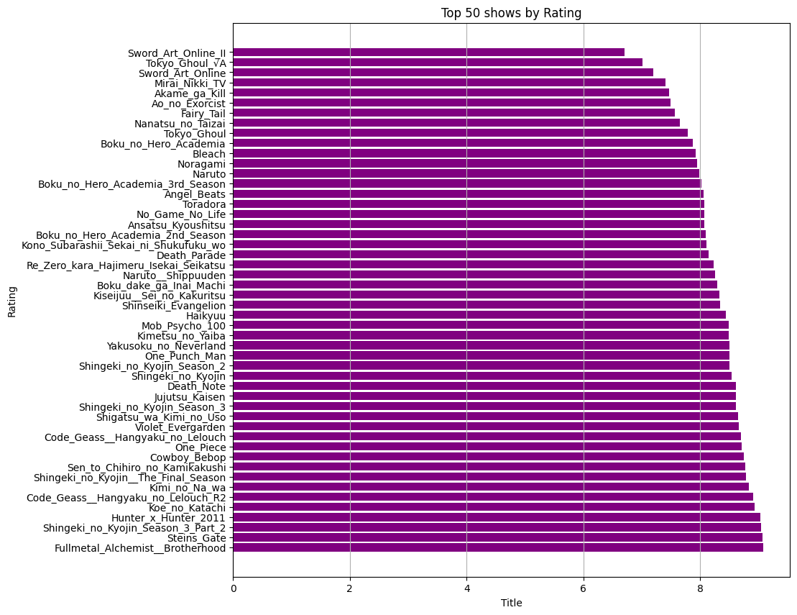
This was odd because when we calculated the average compound score versus the show ratings:
Review Sentiment
Show Ratings
Fun fact: Full Metal Alchemist (highest rating out of 10 stars and is the most review bombed show)

Slide 7
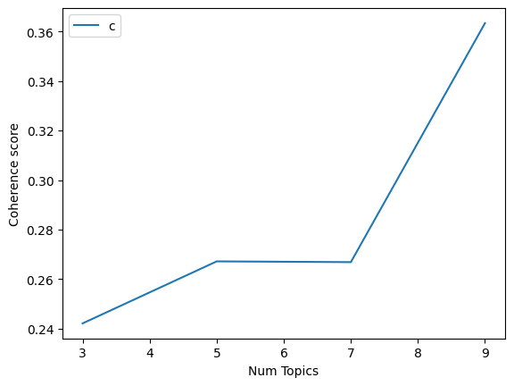
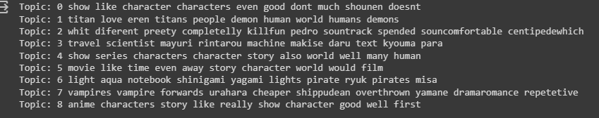
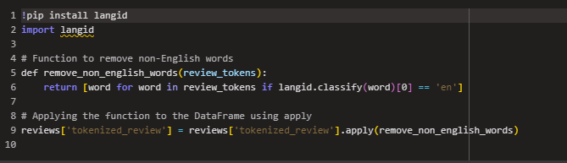
Step 4: LDA
Coherence calculation for optimal topic number
Running LDA
Some reviews were outputted in Spanish for some reason even though I did try removing it with NLTK’s library AND langid’s library/ the others were not even in Spanish

Slide 8
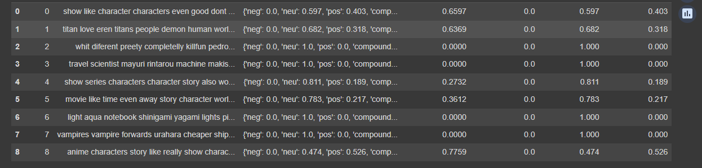
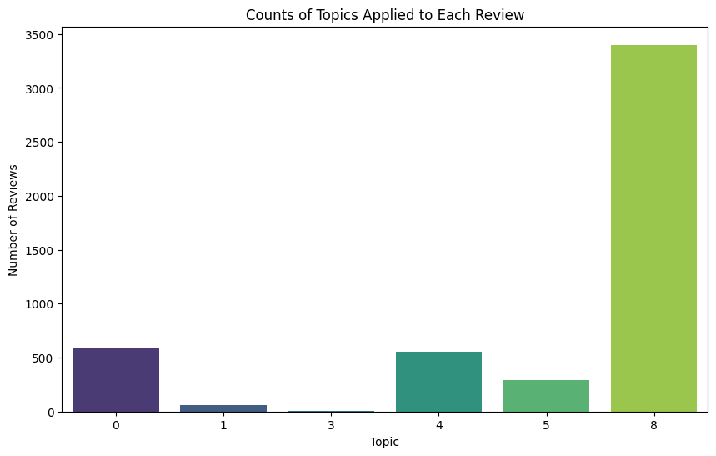
Step 5: Vader Compound Score on LDA Topics
Scoring the reviews by
[pos , neu, neg]
Breaking down the Vadar compound score .
8 topics were generated splitting the review counts across the bar chart.

Slide 9

Future Improvement
Web scraping more reviews to keep the dataset less biased.
Web scraping of each show’s top middle and bottom pages (since it requires multiple-day process).
Finding open sources that don’t restrict large options to web scrap.
Using more advanced technologies to analyze this type of interest research.

